Slide 1

DEPARTMENT OF
ARTIFICIAL INTELLIGENCE AND DATA SCIENCE
ACADEMIC YEAR 2025 - 2026
SEMESTER III
ARTIFICIAL INTELLIGENCE LABORATORY
MINI PROJECT REVIEW
Rock Paper Scissor Using Decision Making Algorithm
REGISTER NUMBER
NAME | DEVESH A
YEAR | II
SECTION | A
FACULTY IN-CHARGE | Mrs. M. Divya

Slide 2
PROBLEM STATEMENT
Brief Overview of Artificial Intelligence:
This project is an advanced version of the Rock–Paper–Scissors game implemented using Python. It integrates a modern graphical user interface (GUI) with Tkinter, a scoreboard, and a simple AI prediction system that learns from the player’s past moves. The project demonstrates key Artificial Intelligence concepts like pattern prediction, decision-making, and randomness in a fun and interactive way.
Problem Statement:
To design and implement an interactive Rock–Paper–Scissors game using Python that allows continuous play, maintains a scoreboard, and applies a simple AI prediction model based on the user’s past moves, combined with randomness to make the computer’s responses intelligent and unpredictable.
Expected Result:
The program offers an interactive Rock–Paper–Scissors game using Tkinter, where users play continuously against the computer. It displays round results, maintains a live scoreboard, and uses a simple AI to predict the user’s next move. Players can reset or quit anytime. The goal is to create an enjoyable, intelligent, and user-friendly gaming experience.
Possibilities:
Future enhancements could include AI-based move prediction, engaging visuals and sound effects, online multiplayer mode, performance tracking, and mobile or web versions using frameworks like Kivy or Flask — making the game more intelligent and interactive.

Slide 3
THEORETICAL BACKGROUND
This project combines concepts from Artificial Intelligence and human-computer interaction. The random module provides unpredictability in computer decisions, while the AI logic predicts the player’s next move based on their previous choices. The Tkinter GUI offers a user-friendly interface with buttons, labels, and live score updates. It demonstrates decision-making algorithms, pattern recognition, and event-driven programming in Python.

Slide 4
IMPLEMENTATION AND CODE
Link to code in Git-hub Repository
List | Git-hub Repository Links
Implementation of Code Link | AI-mini-project-/Rock paper scissors at main · Devesh-1406/AI-mini-project- · GitHub
Word Document Report Link | AI-mini-project-/DEVESH AILAB_MINI_PROJECT_TEMPLATE_AI&DS update.docx at main · Devesh-1406/AI-mini-project-
PPT Link

Slide 5
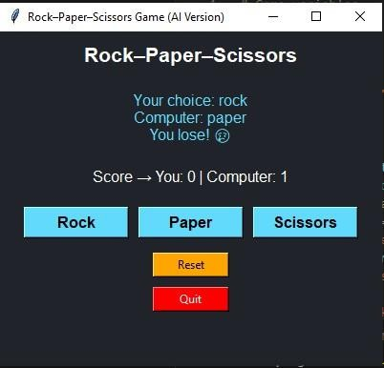
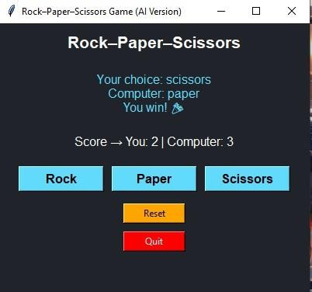
OUTPUT AND RESULTS
OUTPUT :
EXPLANATION :
The project is a Python-based Rock–Paper–Scissors game that uses Artificial Intelligence logic and a Graphical User Interface (GUI) created with Tkinter. The player interacts with the system by selecting Rock, Paper, or Scissors using on-screen buttons.The computer’s move is generated using a hybrid algorithm — a combination of random selection and a frequency-based prediction model. The prediction model observes the user’s previous choices, identifies which move the player uses most often, and selects a counter move to increase its chances of winning.Each round’s result is displayed instantly, and a scoreboard keeps track of the player’s and computer’s points. The Reset button allows restarting the game, while the Quit button exits the application.This project demonstrates the practical use of decision-making algorithms, pattern recognition, and event-driven programming in Python, showing how simple AI can be applied to create an interactive and intelligent game.

Slide 6
OUTPUT AND RESULTS
Result:
The system successfully allows continuous gameplay with a real-time scoreboard and a simple AI model that predicts the user’s next move. The GUI provides an easy and interactive gaming experience.
Future Enhancement:
Integrate deep learning models for more advanced move prediction.
Add sound effects and animations.
Enable multiplayer online mode.
Store user history for long-term learning.

Slide 7
REFERENCES
  https://docs.python.org/3/library/random.html
  https://docs.python.org/3/library/tkinter.html
  https://realpython.com/python-gui-tkinter/
  https://www.geeksforgeeks.org/python-tkinter-tutorial/
  https://www.programiz.com/python-programming/examples

